Slide 1
Portfolio Milestone
Portfolio Milestone requirement for the Master of Science in Applied Data Science at Syracuse University ^{Student: Nash Delcamp} ^{SUID: 364592830} ^{E-mail: ndelcamp@syr.edu}
Link to portfolio: Applied Data Science Portfolio Milestone

Slide 2
Learning Objectives Review
Collect and organize data
Identify patterns in data via visualization, statistical analysis, and data mining
Develop alternative strategies based on the data
Develop a plan of action to implement the business decisions derived from the analyses
Demonstrate communication skills regarding data and its analysis for a wide range of audiences

Slide 3
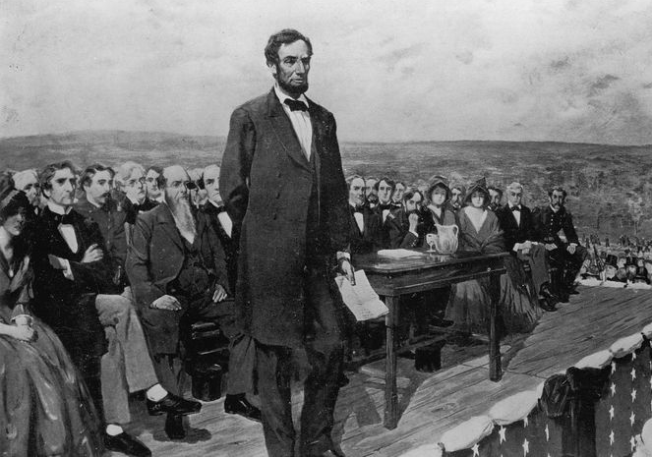
Presidential Speeches
IST 736 – Final Project Drew Howell and Nash Delcamp

Slide 4
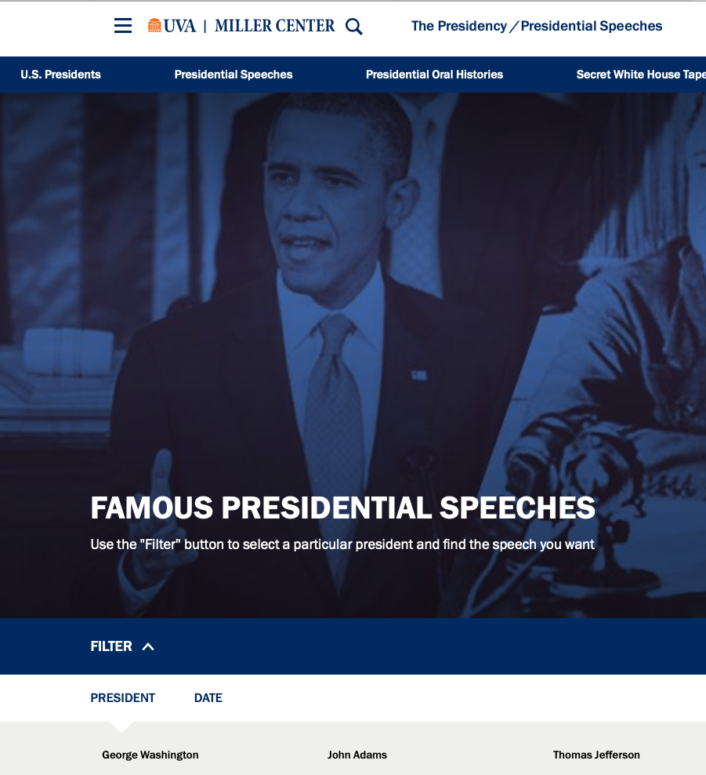
Introduction
Presidential addresses to the public are important and meticulously worded
What can we learn through text mining to better understand our leaders?
The data: The Miller Center’s transcripts of each president’s top three speeches along with metadata per president
Notes:
Every direct and formal address to the public by the president is very important
Couldn’t find any other projects with a quick search online that used text mining to analyze speeches
Trying to see if text mining can offer any deeper insight into how I favorite presidents stand out, the general sentiment of parties, etc.
Describe third bullet
Besides this being interesting per se, it might also help us evaluate our current leader based on his speeches in an analytical and fact-based way.

Slide 5
Sentiment Over Time (vaderSentiment)
Increasing variance in 20th century
Positive range = 0.14
0.34 - 0.2
Negative range = 0.075
0.15 – 0.075
Trend line increases for both

Slide 6
K-means
Cluster | Avg. Date | Avg. Word Count | Avg. Neg Score | Avg. Pos Score | Avg. Term Length | Speeches | Democrat | Republican | Other Party
1 | 1969 | 1501 | 0.124 | 0.268 | 5.45 | 47 | 40% | 51% | 9%
2 | 1867 | 2217 | 0.093 | 0.239 | 4.62 | 75 | 27% | 37% | 36%
Group 1: New School
Average speech is 50 y/o
2-party system
Shorter and poignant
Group 2: Old School
Average speech is 150 y/o
Several parties
Long-winded and boring (less emotional)
Cluster | Avg. Date | Avg. Word Count | Avg. Neg Score | Avg. Pos Score | Avg. Term Length | Speeches | Democrat | Republican | Other Party
1 | 1868 | 5553 | 0.080 | 0.219 | 4.30 | 15 | 13% | 47% | 40%
2 | 1974 | 1533 | 0.121 | 0.269 | 4.67 | 43 | 37% | 56% | 7%
3 | 1853 | 1264 | 0.093 | 0.190 | 5.59 | 20 | 40% | 20% | 40%
4 | 1876 | 1416 | 0.103 | 0.269 | 4.60 | 44 | 30% | 39% | 32%
Group 1: Please Stop Talking
Long, dry speeches
Group 2: New School (Again)
Replica of k2,G1
Most distinct cluster
Group 3: The Quick And Easy Liberals
Short speeches
Least variance of sentiment
Lowest sent in both categories
Group 4: Emotional Old Men
Every Lincoln speech
Largest sentiment variance

Slide 7
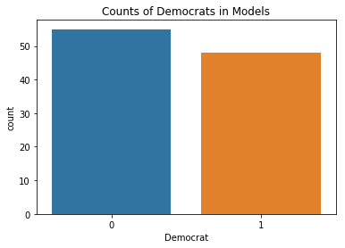
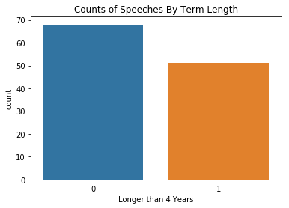
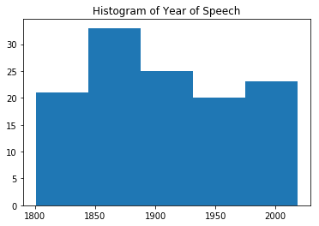
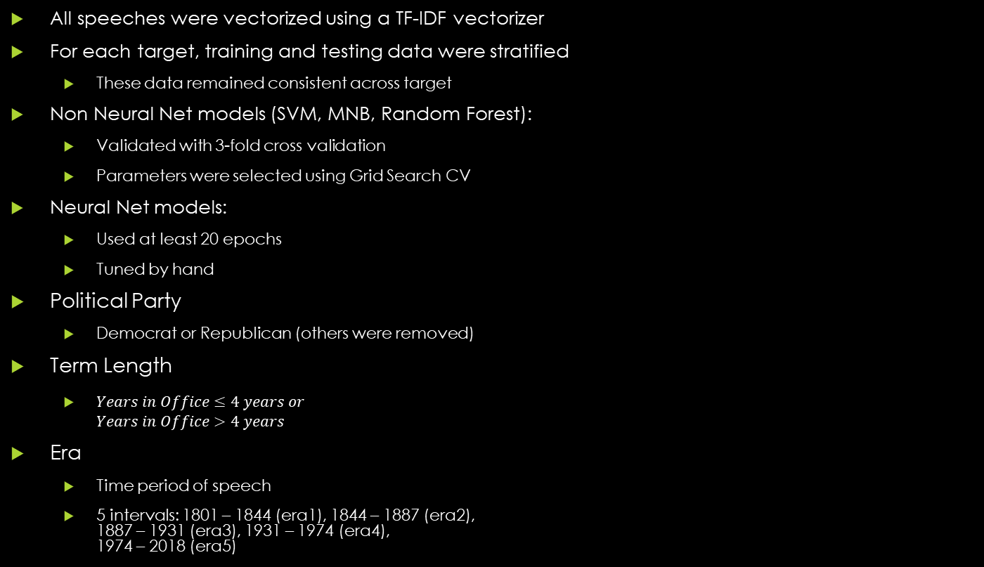
Prediction Models
All speeches were vectorized using a TF-IDF vectorizer
For each target, training and testing data were stratified
These data remained consistent across target
Non Neural Net models (SVM, MNB, Random Forest):
Validated with 3-fold cross validation
Parameters were selected using Grid Search CV
Neural Net models:
Used at least 20 epochs
Tuned by hand
Political Party
Democrat or Republican (others were removed)
Term Length
$Years in Office≤4 years or$ $Years in Office>4 years$
Era
Time period of speech
5 intervals: 1801 – 1844 (era1), 1844 – 1887 (era2), 1887 – 1931 (era3), 1931 – 1974 (era4), 1974 – 2018 (era5)

Slide 8
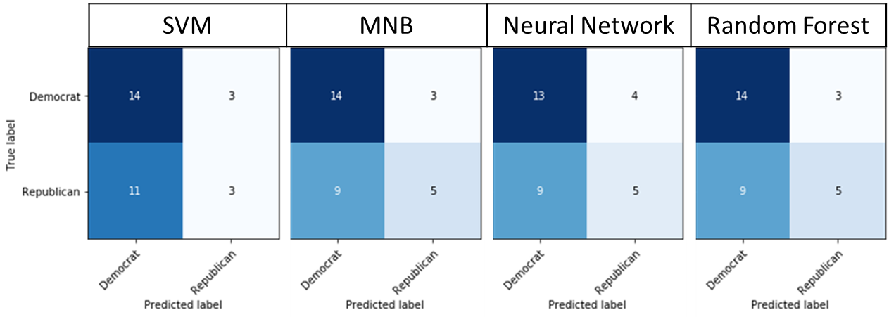
Predicting Political Party Base Accuracy = 0.548
Model | Parameters | Test Accuracy | Precision | Recall | F1- score
SVM | C = 100 | 0.548 | 0.53 | 0.52 | 0.48
MNB | alpha = 10⁻⁶ | 0.613 | 0.62 | 0.59 | 0.58
Neural Network | Dense relu, 50 Dense softmax, 2 epochs = 20 | 0.581 | 0.57 | 0.56 | 0.55
Random Forest | max_depth = 10 max_features = log2 | 0.613 | 0.62 | 0.59 | 0.58
Notes:
Relu is Rectified Linear Unit.
Softmax is Softmax activation function.
Max_features is the number of features to consider when looking for the best split. Log2 means log2(n_features)

Slide 9
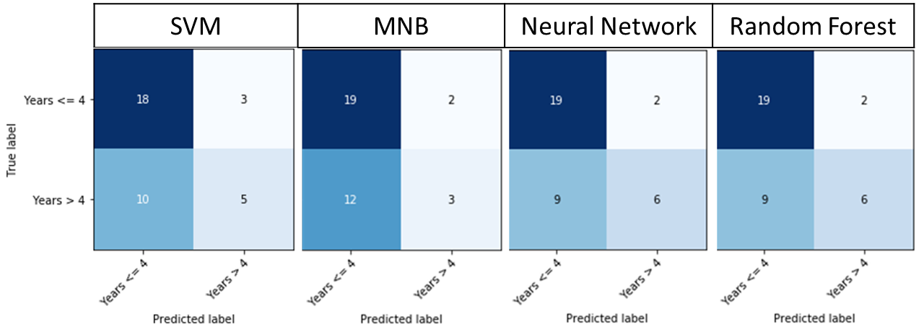
Predicting Term Length Base Accuracy = 0.583
Model | Parameters | Test Accuracy | Precision | Recall | F1- score
SVM | C = 200 | 0.638 | 0.63 | 0.60 | 0.58
MNB | alpha = 10⁻⁶ | 0.611 | 0.61 | 0.55 | 0.52
Neural Network | Dense relu, 200 Dense softmax, 2 epochs = 40 | 0.694 | 0.71 | 0.65 | 0.65
Random Forest | max_depth = 35 max_features = auto | 0.694 | 0.71 | 0.65 | 0.65

Slide 10
Trump Years in Office Neural Network Prediction
Date | Speech | Probability In Office <= 4 | Probability In Office > 4
1/20/2017 | Inaugural Address | 0.315 | 0.685
2/28/2017 | Address Joint Session Congress | 0.497 | 0.503
1/30/2018 | State Union Address | 0.536 | 0.464

Slide 11
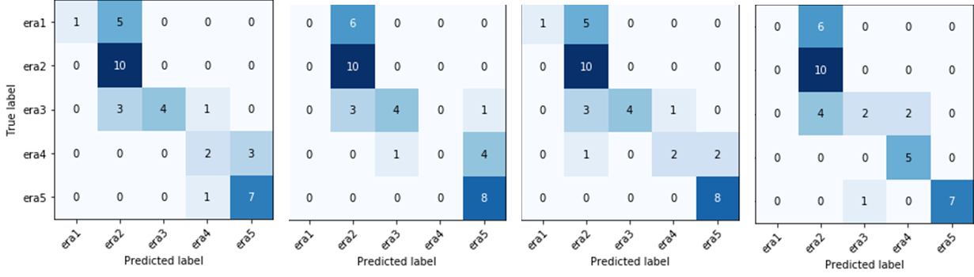
Predicting Time Period Base Accuracy = 0.270
Model | Parameters | Test Accuracy | Precision | Recall | F1- score
SVM | C = 200 | 0.649 | 0.75 | 0.59 | 0.58
MNB | alpha = 10⁻⁶ | 0.595 | 0.39 | 0.50 | 0.41
Neural Network | Dense relu, 800 Dense softmax, 6 epochs = 45 | 0.676 | 0.80 | 0.61 | 0.61
Random Forest | max_depth = 70 max_features = None | 0.649 | 0.58 | 0.62 | 0.56
SVM | MNB | Neural Network | Random Forest

Slide 12
Worldwide Suicide Factors
Nash Delcamp, Keith Kunz, and Allison Roth

Slide 13
Problem and Data
Costs of suicide:
Approximately 800,000 people commit suicide, while even more attempt suicide¹
It is estimated that 10 to 15 percent of patients who engage in medically serious suicide attempts will die by suicide within 10 years²
Total cost is $93.5 billion, or $298 per capita in US alone²
Emotional tolls on family, friends and community members can last years.
Where to focus prevention efforts?
Data:
WHO suicide data for 1985 - 2016
Wikipedia data on gun ownership by country
Wikipedia data on internet usage by country
Final data:
101 countries over 26 years
Other variables include metrics on GPD, sex, age, population, civilian firearms, registered and unregistered firearms and internet usage.
Notes:
AR

Slide 14
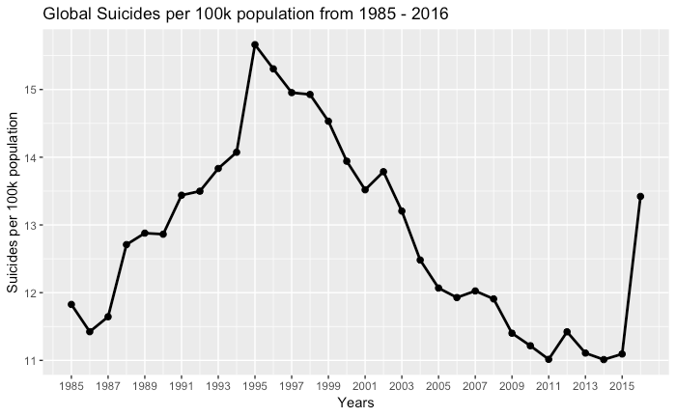
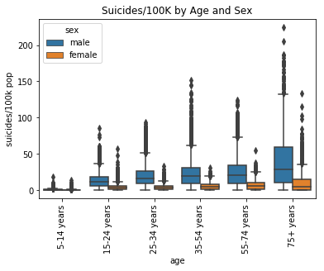
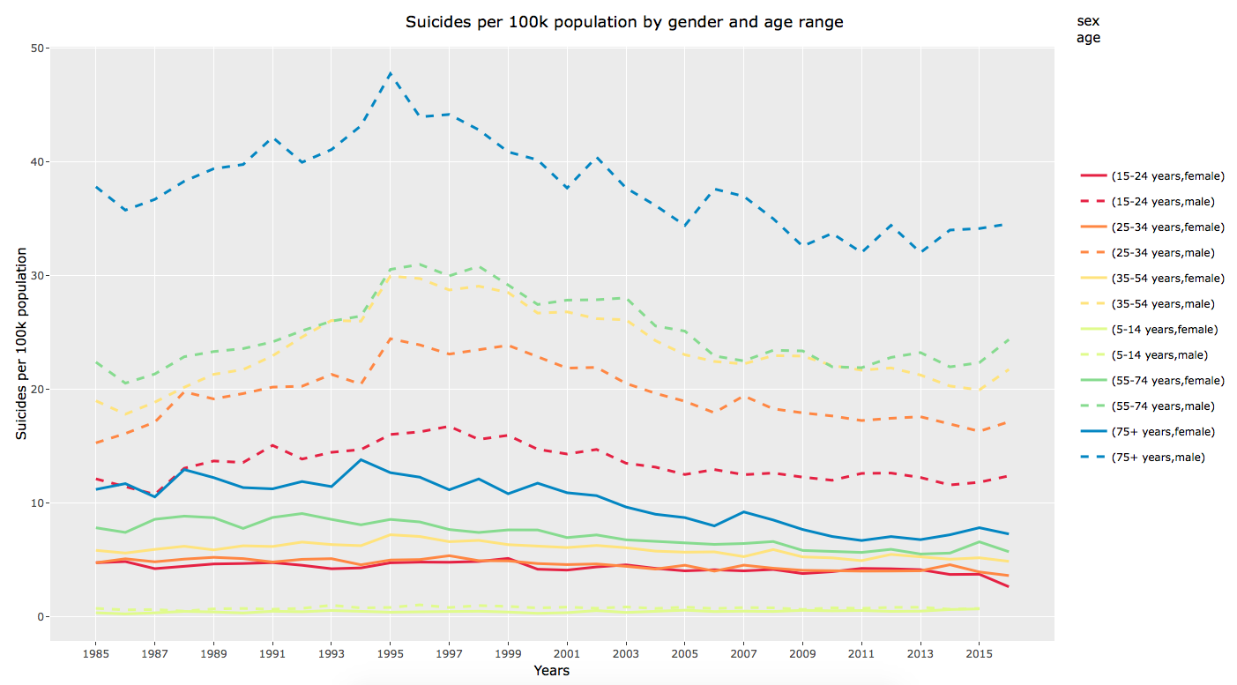
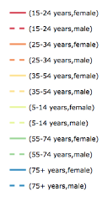
Suicide Trends
Suicide rates peaked in 1995
Declining since, with an uptick in 2016
We anticipate this to be an anomaly; that was an incomplete year for data
Males 75+ years of age have the highest rate
Females 5 -35 have low suicide rates
Males have higher rates of suicide in every age category
Older → higher rate both male and female
v
Notes:
AR

Slide 15
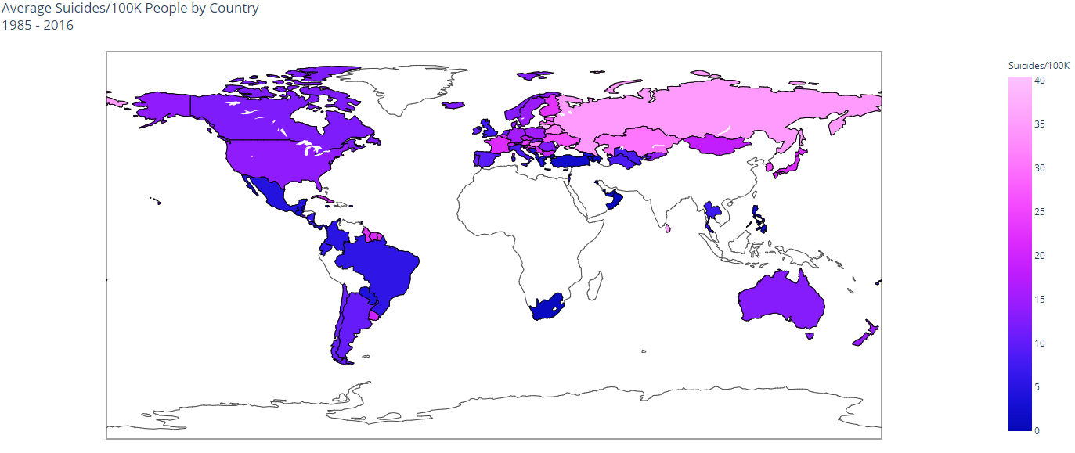
Global View
-Light colors correspond to high suicide rates, darker colors are lower suicide rates.
-North and South America generally lower rates with some higher countries, Europe a mix and Asia with some higher rates
-Sparse data in Africa, parts of the Middle East and Southern Asia
Notes:
As we moved through the exploratory data analysis we wanted to vizualize the suicide rate by country. The data was over-layed as shown here and Light colors correspond to high suicide rates, darker colors are lower suicide rates. North and South America generally lower rates with some higher countries mixed in, Europe was a mix of rates and Asia with some of the higher rates. Of the data that was available, you can see that reporting in Africa and parts of Asia are sparse at best. From here we moved into modeling, starting with a multiple linear regression model.

Slide 16
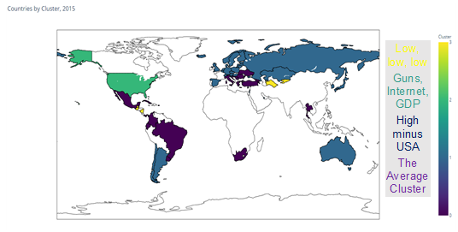
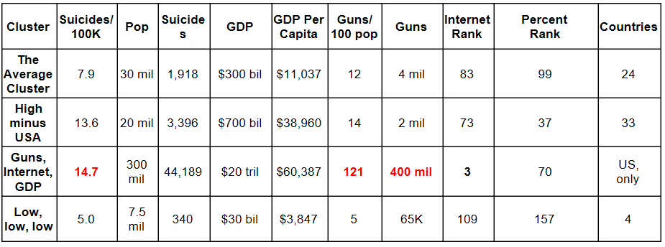
Is the US alone?
K-Means model
Subset to 2015
Clustered using number of guns and percentage of internet accessibility, only.
Notes:
ND

Slide 17
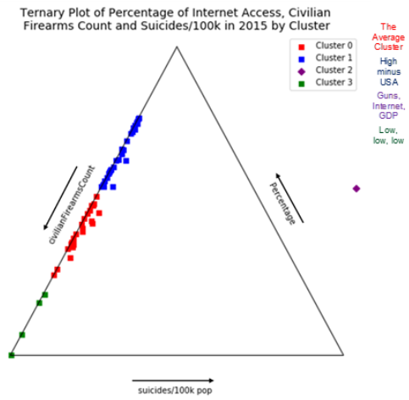
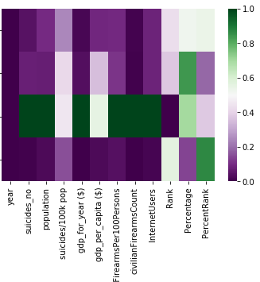
US (alone) Far From Other Clusters
Heatmap by Cluster
The Average Cluster
High minus USA
Guns, Internet, GDP
Low, Low, low
US
Notes:
ND

Slide 18
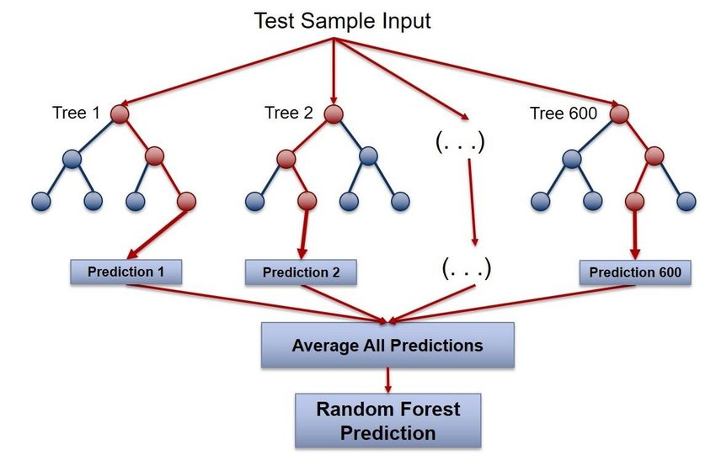
Predicting Rate of Suicide
Random Forest
Base RMSE = 19 (suicides/100k)
Model without age or sex* RMSE = 12
Model with age and sex RMSE = 7
Struggles with low population countries
1 suicides / 500 people → 200 suicides/100k
2 suicides / 500 people → 400 suicides/100k
*year, population, civilianFirearmsPer100Persons, civilianFirearmsCount, InternetUsers, Rank, Percentage
Max depth = 16; max features = auto (sqrt)
Notes:
ND

Slide 19
Recommendation
As seen throughout the data analysis and modeling, the prevailing factors and metrics that determine the suicide rate are age and sex. As age increases, agnostic of sex and other factors, the suicide rate also increases with the older age groups having significantly higher rates. The rate also significantly increases if you are a male.
As a result, it will be important to look at factors that affect both the male and elder population propensity to commit suicide. It will be important that countries around the world focus their efforts on understanding this problem and commit resources to help prevent such tragic events.
Notes:
AR

Slide 20
Student Alcohol Consumption
Group B:
Alex Balter
Nash Delcamp
Rayden Soriano
MAR653 - Marketing Analytics
SPRING 2019

Slide 21

Overview
A survey dataset which includes information regarding student alcohol consumption.
The dataset consists of many family and lifestyle related variables including weekday and weekend alcohol intake (scale from 1-5). Also included are variables related to school performance.

Slide 22
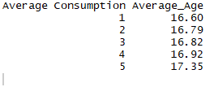
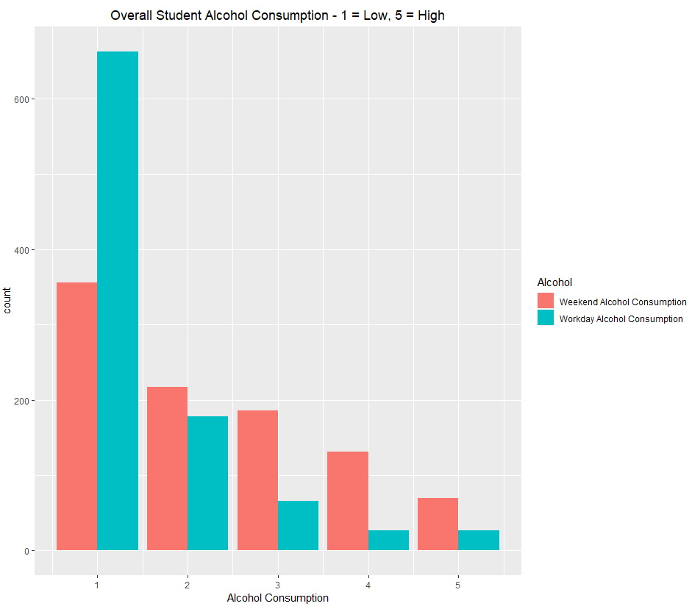
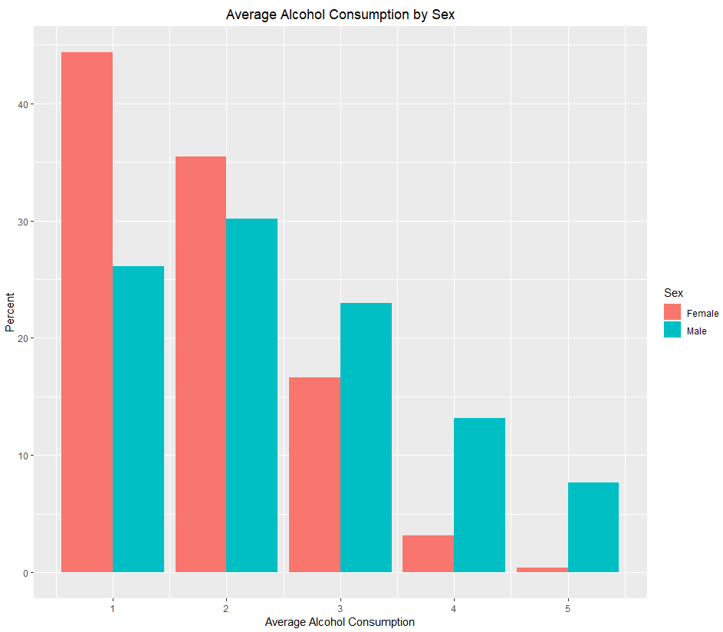
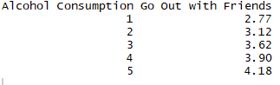
Summary Statistics
Student Alcohol Consumption was rated on a scale from 1 to 5.
1 = Low
5 = High
Overall
In general, older students consumed more alcohol
By Percentage, males consumed more alcohol
Most alcohol consumption takes place on weekends
Going Out with Friends had a large impact

Slide 23
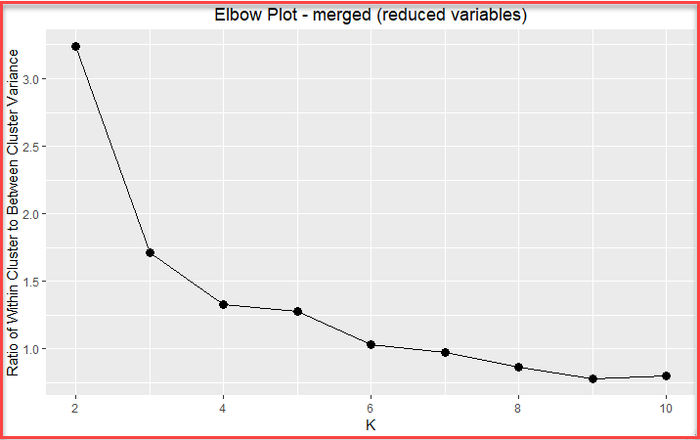
K-Means Clusters
Cluster | Talc | Count | Talc_Center | Cumulative | ratioCluster | ratioTotal
1 | 1 | 116 | 1.49 | 116 | 0.51 | 0.12
1 | 2 | 111 | 1.49 | 227 | 0.49 | 0.12
2 | 3 | 101 | 3.43 | 101 | 0.67 | 0.11
2 | 4 | 33 | 3.43 | 134 | 0.22 | 0.03
2 | 5 | 16 | 3.43 | 150 | 0.11 | 0.02
3 | 1 | 233 | 1.47 | 233 | 0.53 | 0.24
3 | 2 | 207 | 1.47 | 440 | 0.47 | 0.22
4 | 3 | 85 | 3.53 | 85 | 0.60 | 0.09
4 | 4 | 39 | 3.53 | 124 | 0.27 | 0.04
4 | 5 | 18 | 3.53 | 142 | 0.13 | 0.02
4 clusters chosen

Slide 24
K-Means Cluster Centers
Cluster | sex | address | famsize | Pstatus | studytime | romantic | G1.final | G2.final | G3.final | Talc
1 | 1.30 | 1.64 | 1.26 | 1.87 | 1.89 | 1.43 | 2.04 | 1.93 | 1.93 | 1.49
2 | 1.53 | 1.71 | 1.40 | 1.85 | 1.83 | 1.32 | 2.99 | 3.12 | 3.16 | 3.43
3 | 1.38 | 1.78 | 1.28 | 1.88 | 2.15 | 1.34 | 3.07 | 3.14 | 3.22 | 1.47
4 | 1.73 | 1.66 | 1.28 | 1.92 | 1.61 | 1.35 | 2.03 | 1.95 | 1.94 | 3.53
Cluster 1: More female, slightly more urban, larger families, study an average amount, below average grades, and drink very little.
Cluster 2: Even sex split, more urban, slightly larger families, study an average amount of time, have average-above average grades, and drink a lot.
Cluster 3: More female, much more urban, larger families, study an above average amount, have above average grades, and drink very little.
Cluster 4: More male, slightly more urban, larger families, study a below average amount, have below average grades, and drink a lot.
Clusters 1 & 3 have similar alcohol consumption (low), but Cluster 1 has much lower grades.
Clusters 2 & 4 have similar alcohol consumption (high), but Cluster 4 has much lower grades and is more male.

Slide 25
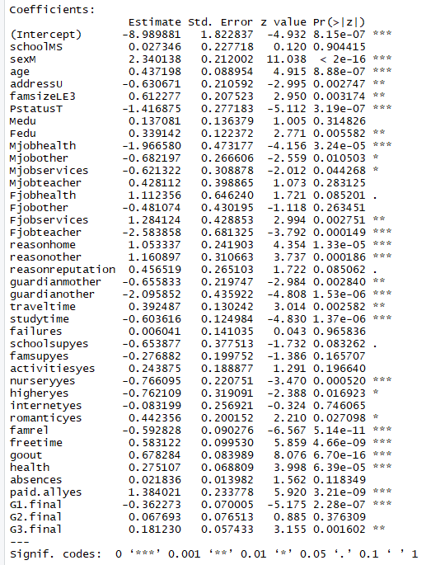
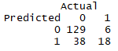
Logistic Regression – Initial Model
Can we predict whether a student has the potential for Alcohol Abuse?
Data Process
“Alcoholic” was defined as a rating of 4 or 5 on the survey scale
This yielded 853 Non-Alcoholics and 106 Potential Alcoholics
Training and Testing Data were created with an 80% - 20% split
A split was done to maintain the proportions of Non-Alcoholics and Alcoholics within both datasets
“Upsampling” was performed on training data to correct class imbalance.
Initial Results 77% Accuracy

Slide 26
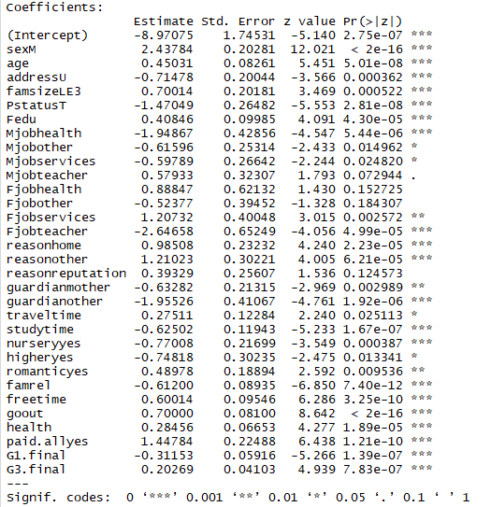
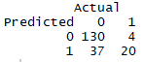
Logistic Regression – Final Model
Insignificant variables were removed
Attr. | Coef. | Finding
SexM | 2.438 | Being Male increases chances for alcohol abuse
PstatusT | -1.470 | Parents still living together decreases chances for alcoholism
Mjobhealth | -1.949 | A mother with a job in the health care field decreases chances for alcoholism
famrel | -0.612 | A quality family relationship decreases chances for alcohol abuse
goout | 0.7 | Going out a lot with friends increases chances for alcohol abuse
The model has a decent sensitivity (identifying true positives), but also has a high false positive rate.
This trade-off may be preferable if being used to identify children prone to alcohol abuse for preventative intervention.
Overall Accuracy 78.5%
True Positive rate (83%)
High False Positive rate (65%)

Slide 27
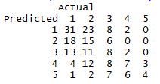
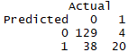
Ordinal Logistic Regression
Ordinal Logistic Regression will attempt to predict the probability of class membership within an ordinal variable. In our case, this was the self-rated Alcohol Consumption on the scale of 1 – 5.
Data Process
Same training and testing data from logistic regression were used.
Training data was “upsampled” in order to balance classes (1, 2, 3, 4, 5).
Insignificant variables were removed from initial model.
Initial results were unattractive, but predicted value was converted using same >= 4 logic…
Leading to very similar results from logistic regression.

Slide 28
Clusters in Logistic Predictions
Logistic | Cluster
Prediction | 1 | 2 | 3 | 4
0 | 0.75 | 0.55 | 0.87 | 0.29
1 | 0.25 | 0.45 | 0.13 | 0.71
Clusters 2 & 4 are the clusters with greater alcohol consumption.
Ordinal Logistic | Cluster
Prediction | 1 | 2 | 3 | 4
0 | 0.84 | 0.58 | 0.85 | 0.32
1 | 0.16 | 0.42 | 0.15 | 0.68

